Slide 1
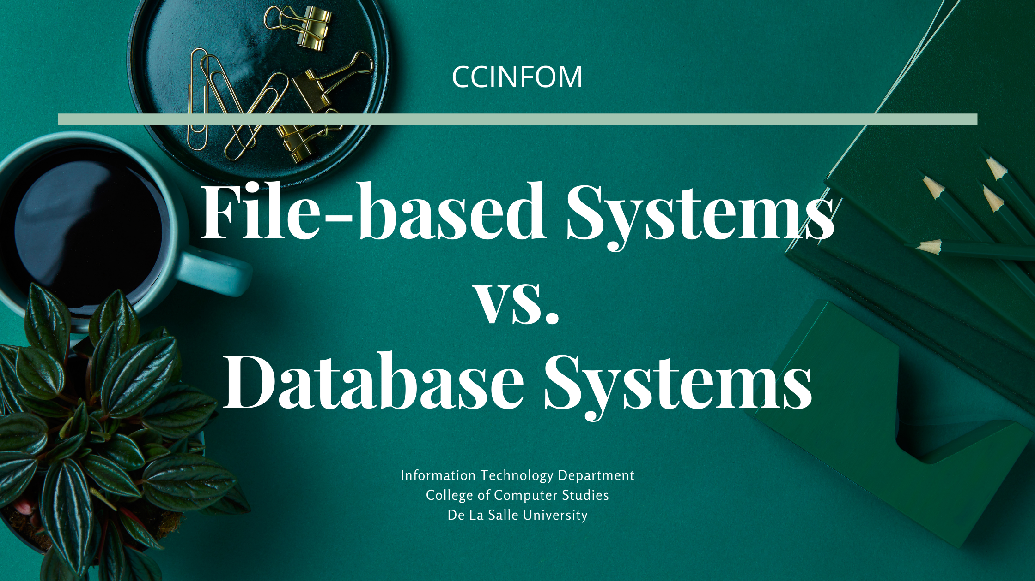
Notes:
Welcome to this session on File-based & database systems, where the components & structure of these types of systems will be discussed. The evolution of database systems to overcome the challenges with traditional file-based systems will also be presented.

Slide 2


What did we cover in the last session?
Data & Information (and Knowledge)
Overview of Database Applications
Anatomy of Database Applications (in terms of capability)
Architectures used to implement Database Applications
Dimensions of Quality Information
Data Management Lifecycle & Processing
Collection → Storage → Processing → Sharing → Presentation
Four (4) Types of Data Processing
Notes:
We defined what data & information are, as well as knowledge, and how they are are produced.
The different characteristics or dimensions of quality information and their importance were also presented.
Lastly, we also covered the phases of the data management lifecycle & the 4 types of data processing.

Slide 3

Agenda
Understanding File-Based Systems
Understanding the issues WITH File-Based Systems
Understanding the basics of Database Systems
Information Technology Department
De La Salle University
Notes:
This session aims at understanding what file-based systems are and their structure; understanding the issues of file-based systems; and understanding the basics of database systems and how they came about.

Slide 4
File-based Systems
File
Application Software
File Types
Text File
Binary File
Mode of Storing Data
One type of Record is stored in one file
Coded with data management functions
Collection
Storage
Processing (Types 1 to 4)
Distribution
Presentation
Information Technology Department
De La Salle University
Notes:
File-based systems are composed of an application software, which has access to files.
File types can either be text or binary.

Slide 5
Data Management Lifecycle
Collected or Created
Stored and Organized
Processed
Presented or Used
Shared or Distributed
Information Technology Department
De La Salle University

Slide 6
Data Processing
Type 1
Relating data together to form records
Type 2
Mathematical processing
Updating and deletion of data
Type 3
Relating records to each other
Type 4
Generation of reports
Generation of lists
Includes grouping, filtering, and sorting
Information Technology Department
De La Salle University

Slide 7
File-based Systems
HUMAN RESOURCES DEPARTMENT
File
Application Software
Employee File
Name
Contact No.
Address
Date Hired
Salary
Tax Bracket
No. of Dependents
File Management
File Report
Information Technology Department
De La Salle University
Notes:
Let’s look at an example of a file-based system the human resources department. The HR department can keep records of their employees and individually store them in files containing the employee’s name, contact number, address, the date he/she was hired, salary, tax bracket, and their number of dependents.

Slide 8

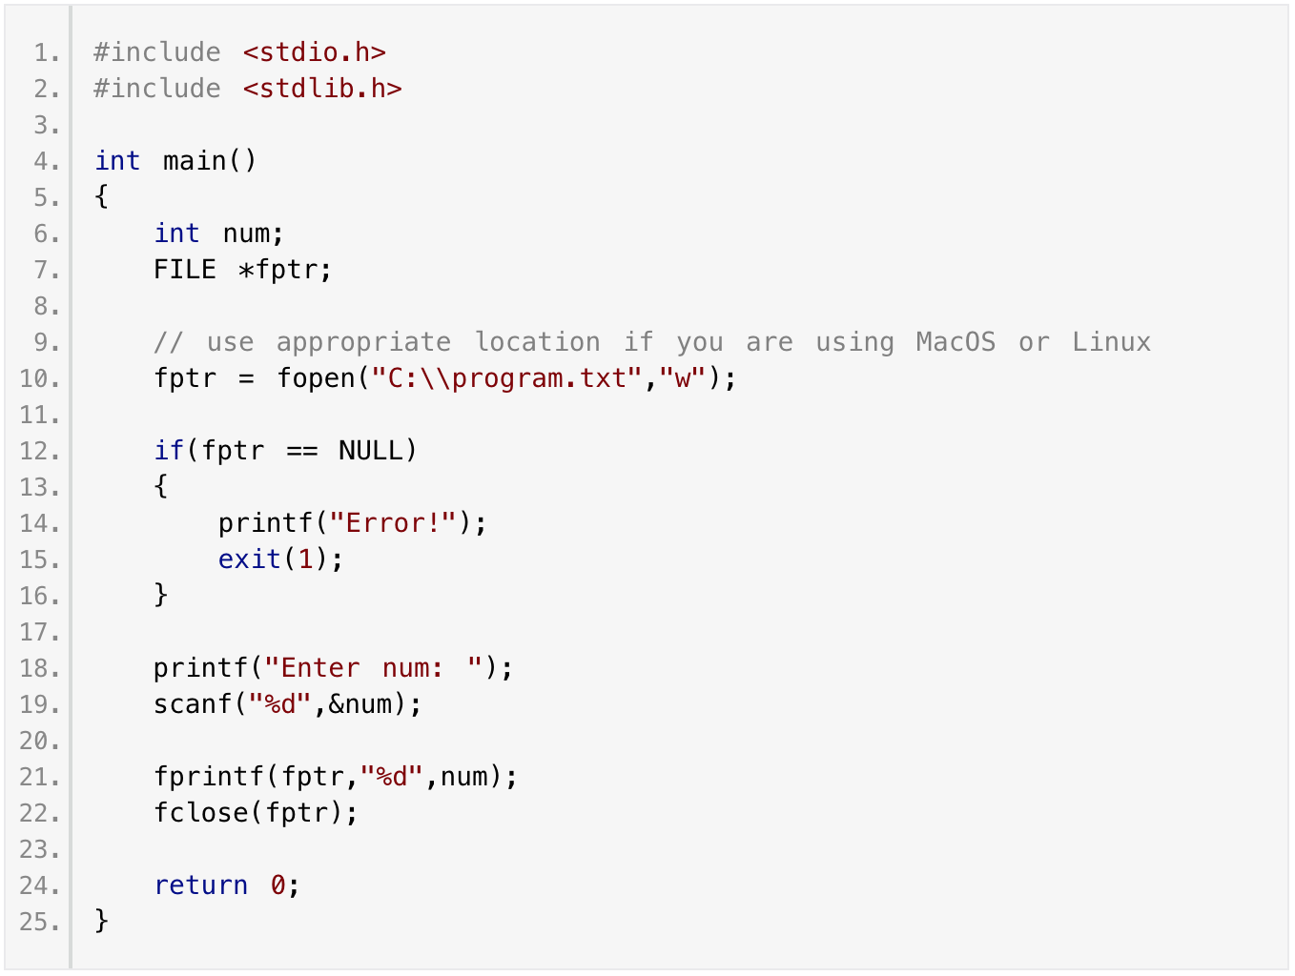


Programmer’s view of the application software in a file-based system
Writing data into a text file
Information Technology Department
De La Salle University

Slide 9
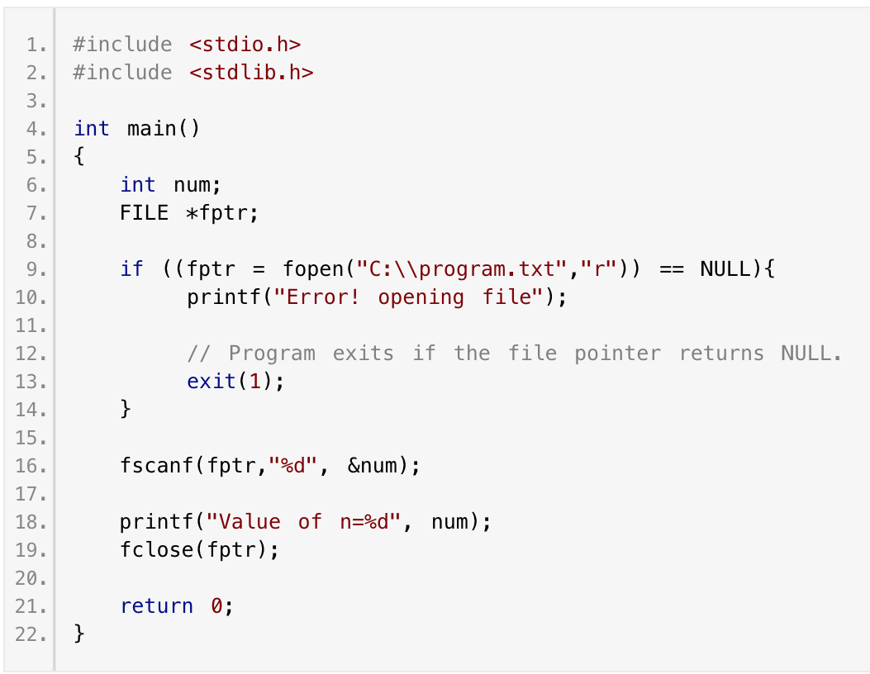
Programmer’s view of the application software in a file-based system
READING data FROM a text file
Information Technology Department
De La Salle University

Slide 10
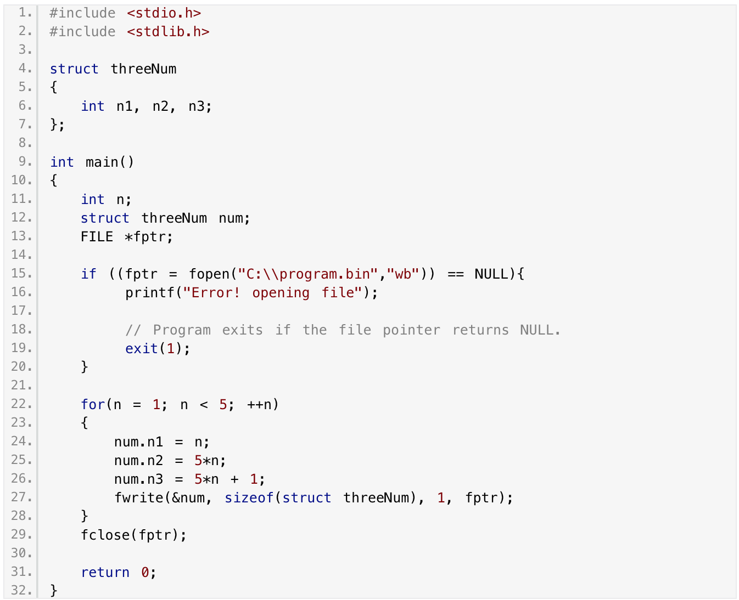
Programmer’s view of the application software in a file-based system
WRITING data INTO a BINARY file
Information Technology Department
De La Salle University

Slide 11
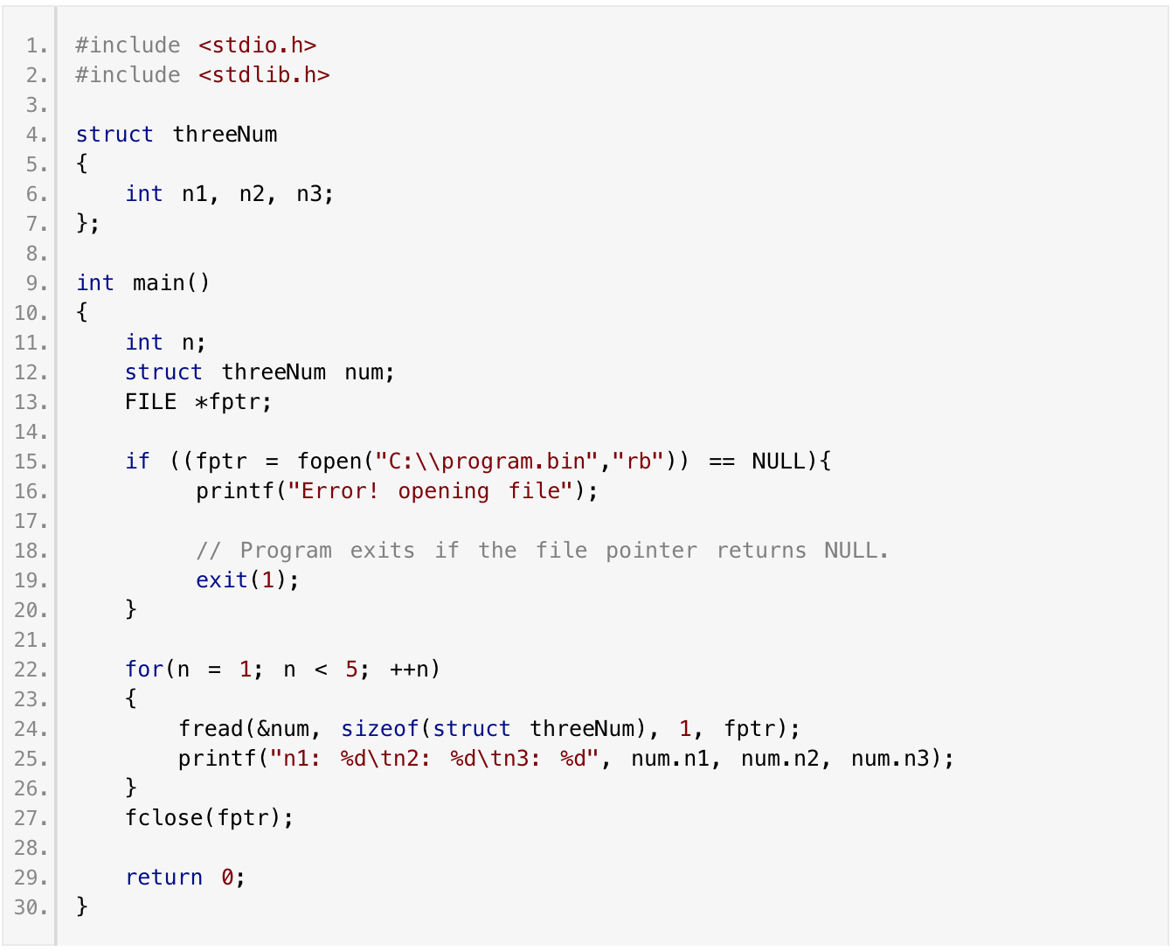
Programmer’s view of the application software in a file-based system
READING data FROM a BINARY file
Information Technology Department
De La Salle University

Slide 12
Let’s Test your FILE SKILLS
You have the following BINARY files:
Provide an optimized algorithm that will complete enrollment of a student in a course. Take note:
Enrollment is valid if student is valid
Course is valid if
Course has not been taken by the student
Course has been taken by the student and failed
Try coming up with a solution in 3 minutes
FILE 1
Student Data
FILE 2
Course Data
FILE 3
Enrollment & grade data of student in a course
Information Technology Department
De La Salle University

Slide 13
The Algorithm
Set enrollment to VALID
Check if student exists in the student file. If it doesn’t exist, then enrollment is not valid
Check if the course exists in the course file. If it doesn’t exist, then enrollment is not valid
Check if the student previously enrolled in the course using the enrollment file
If YES, check if the grade is Zero, if not ZERO then enrollment is not valid
If enrollment is VALID, create a new record in the enrollment file containing the student and the course being enrolled, with a blank grade
Information Technology Department
De La Salle University

Slide 14
What seems to be known to the programmer when coding Application Software in a File-Based System?
File location
File type (text or binary)
File operation (write or read)
Structure of data in the file
How to code instructions to manipulate data in every file
Search code
Update, delete and insert code
Sorting code
Validation codes
Code for checking other files for referencing purposes

Slide 15
User’s view of the Application Software in a File-Based System
The only way to access the file is through the software program (unless the file is a text file)
Cannot share the file unless:
the user is a user in the software the file is being used on
it is a text file
Only one user can use the file at a time
if used with an application

Slide 16
Issues about File-Based Systems
Application Software
Student Registration
Application Software
Enrollment
Application Software
Course Profile
Application Software
Student Org
Application Software
Dept Operation
Student
Enrollment
Courses
Student
Courses
Data became isolated
Proliferation of data redundancy and inconsistencies
Information Technology Department
De La Salle University
Notes:
A critical look at the file system method allows you to understand its shortcomings, which led to the development of modern databases. The following issues about file-based systems that will be discussed here, severely challenge the types & accuracy of information that can be created from the data.
Using databases & database systems is not fool-proof. If you were unaware of the problems with file-based systems, these problems can still recur and be committed in a database environment.

Slide 17
Issues about File-Based Systems
Application Software
Student Registration
Application Software
Enrollment
Application Software
Course Profile
Application Software
Student Org
Application Software
Dept Operation
Student
Enrollment
Courses
Student
Courses
Difficulties to relate data to another data
Security of data
Information Technology Department
De La Salle University

Slide 18
Issues about File-Based Systems
Application Software
Student Registration
Application Software
Enrollment
Application Software
Course Profile
Application Software
Student Org
Application Software
Dept Operation
Student
Enrollment
Courses
Student
Courses
Difficulties in sharing data among different applications
Adding new fields in the file structure will result to recoding of all programs using it even if the program is not going to use it
Information Technology Department
De La Salle University

Slide 19
How do we solve this problem?
Application Software
Student Registration
Application Software
Enrollment
Application Software
Course Profile
Application Software
Student Org
Application Software
Dept Operation
Student
Enrollment
Courses
Student
Courses
Information Technology Department
De La Salle University

Slide 20
Database Systems
Application Software
Student Registration
Application Software
Enrollment
Application Software
Course Profile
Application Software
Student Org
Application Software
Dept Operation
DBMS
Database
Student
Enrollment
Courses
Information Technology Department
De La Salle University

Slide 21
Database Systems
Database
DBMS
Database Application
Collection of Files
Not anymore known to the Application, nor to us, it’s the DBMS who only knows
Mode of Storing Data
Not anymore known to the Application, not to us, it’s the DBMS who only knows
Coded with data management functions
Collection
Storage
Processing (Types 1 to 4)
Distribution
Presentation
Uses a Data Model
To provide a conceptual/logical representation of how data is stored
Uses a Database Language
Information Technology Department
De La Salle University

Slide 22
Remember this?
Application Software
Student Registration
Application Software
Enrollment
Application Software
Course Profile
Application Software
Student Org
Application Software
Dept Operation
Student
Enrollment
Courses
Student
Courses
Information Technology Department
De La Salle University

Slide 23
Database Systems
Application Software
Student Registration
Application Software
Enrollment
Application Software
Course Profile
Application Software
Student Org
Application Software
Dept Operation
DBMS
Database
Student
Enrollment
Courses
Information Technology Department
De La Salle University

Slide 24
Programmer’s view of the application software in a database system
For the examples, we assume that the database was created to store data about users
ID | FIRST_NAME | LAST_NAME | DATE_CREATED | IS_ADMIN | NUM_POINTS
Information Technology Department
De La Salle University

Slide 25
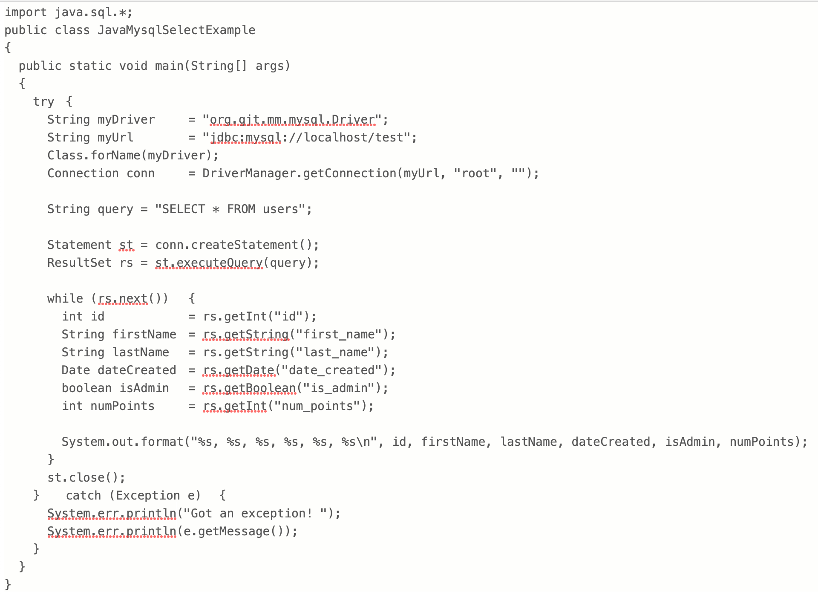
Programmer’s view of the application software in a database system
READING DATA FROM DATABASES
Information Technology Department
De La Salle University

Slide 26
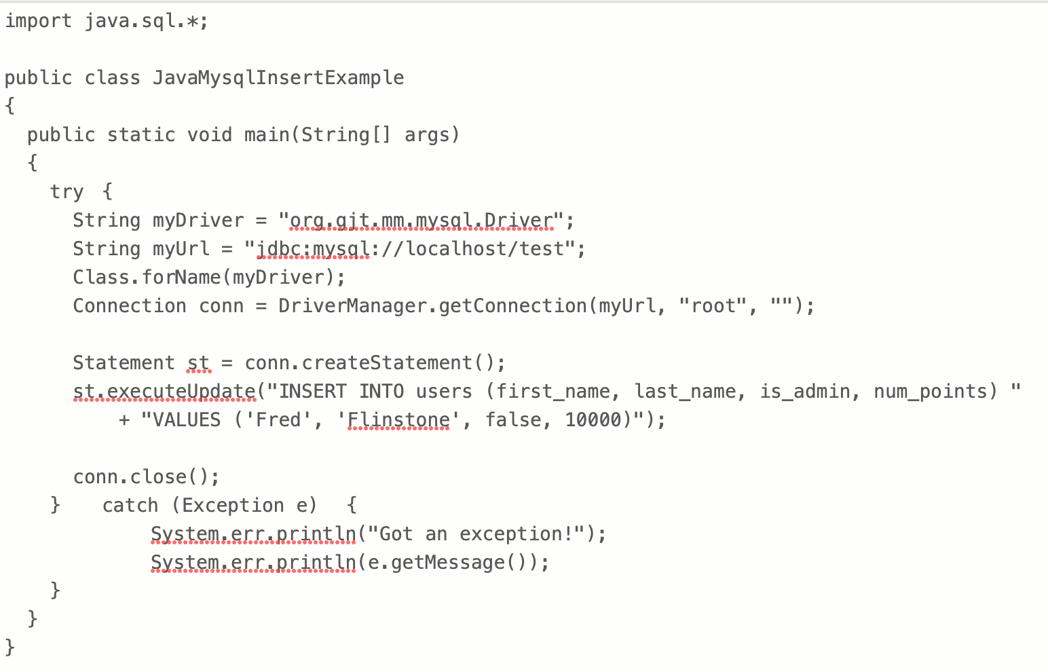
Programmer’s view of the application software in a database system
WRITING DATA INTO DATABASES
Information Technology Department
De La Salle University

Slide 27
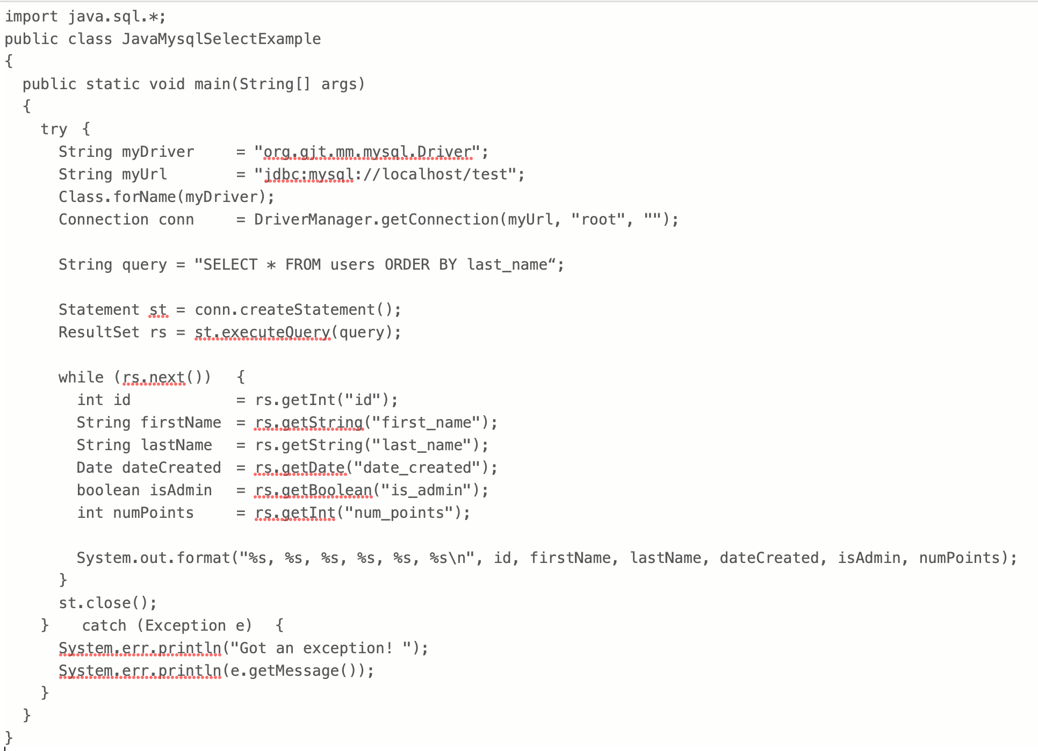
Programmer’s view of the application software in a database system
READING A SORTED SET OF DATA FROM DATABASES
Information Technology Department
De La Salle University

Slide 28
But wait! There’s more. (among so many others)
Searching is done by the DBMS, not the programmer
Sorting the results is done by the DBMS, not the programmer
Checking if data is duplicate is done by the DBMS, not the programmer
Information Technology Department
De La Salle University

Slide 29
And it is not only the application software that can access the data
Using DBMS tools, other users who were given access rights to the database can access the data
Database
DBMS
DBMS Tool
(MySQL Workbench)
Information Technology Department
De La Salle University

Slide 30
Are files EVIL?
NO.d
There will always be a place for files to be used as a way to store data.
But in situations where “data” to be stored:
Unstructured (pictures, movies, documents, etc.)
Applications involve uploading of files
No complex requirements such as security, relationships of data from other data, data manipulation
Information Technology Department
De La Salle University
Notes:
No, definitely not.
We don’t always need a database or database system for storing everything. There will always be a place for files to be used as a way to store data.

Slide 31
References
Coronel, C. & Morris, S. (2017). Database systems: design, implementation, and management, 13th ed. Boston, MS: Cengage Learning.
Information Technology Department
De La Salle University

Slide 32
Questions?
PLEASE POST YOUR QUESTIONS IN THE DISCUSSION BOARD CREATED FOR THIS TOPIC.
Information Technology Department
De La Salle University
Notes:
If there is an AnimoSpace discussion board created in your class for this topic, kindly post your questions there in order for the rest of the class to see the replies. Otherwise, you may reach out to your instructor through the communication channels provided.

Slide 33

Notes:
That is the end of this session. Please check the AnimoSpace course for your section and keep yourself updated regarding other relevant materials or tasks on this topic. Thank you and keep safe always.

